Slide 1


Post-MDT Oncology Workflow Bottlenecks
A Design-Science Study of an NHS Integrated Data Repository and Decision Support Dashboard
Mark Collins
August 2026
Notes:
Good afternoon. My name is Mark Collins, and today I’ll be presenting my MSc dissertation project, which focuses on reducing delays between MDT outcome and treatment initiation in NHS oncology pathways through a Design Science Research approach.

Slide 2
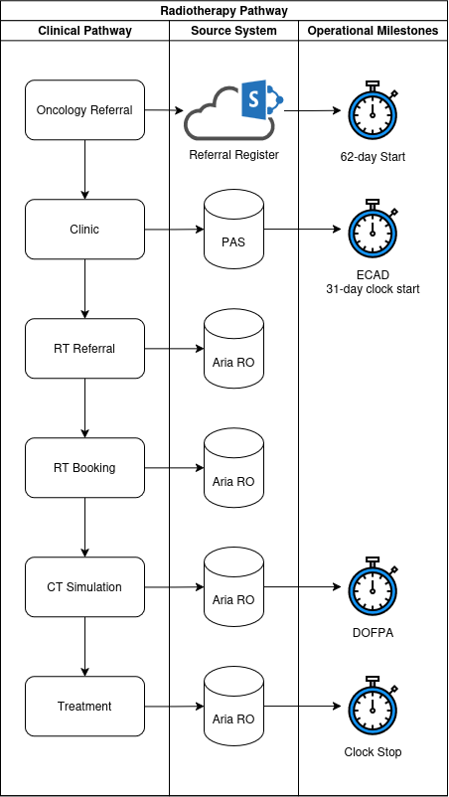
Why This Matters
Timely Cancer treatment is critical for outcomes
New NHS standards
28-day FDS
31-day DTT
62-day RTT
Post-MDT delays remain poorly visible
Johnson (2024)
Notes:
Timely cancer treatment is critical. Delays at any stage — diagnosis, MDT decision, clinic access, or treatment planning — can worsen outcomes, reduce patient experience, and impact national performance standards.
The NHS now focuses on three key standards:
28‑day Faster Diagnosis Standard
31‑day Decision‑to‑Treat to Treatment
62‑day Referral‑to‑Treatment
Yet many Trusts still struggle with fragmented data, inconsistent reporting, and limited visibility of post‑MDT workflow delays.

Slide 3

The Problem
Operational data fragmented across siloed systems
Manual spreadsheet & inconsistent reporting
Bottlenecks hidden until breaches occur
Delays between MDT outcomes and treatment initiation remain insufficiently visible
Notes:
Across Portsmouth Hospitals University NHS Trust, operational data is scattered across:
MDT systems
PAS clinic systems
Radiotherapy systems
Manual referral registers
This fragmentation means:
Bottlenecks are hidden
Breach risks are spotted too late
Operational teams rely on manual spreadsheets
National standards are monitored retrospectively rather than proactively
As the dissertation states:
“Delays between MDT outcomes, first oncology clinic, decision‑to‑treat, and first definitive treatment remain insufficiently visible.”

Slide 4
Research Aim
Design & Evaluate an IDR + dashboard suite
Improve operational visibility
Support proactive pathway management
Notes:
To design and evaluate an Integrated Data Repository (IDR) and decision‑support dashboard capable of improving operational visibility and proactive management of post‑MDT oncology pathways.

Slide 5
Research Objectives
Identify
Identify post-MDT delays
Analyse
Analyse operational factors
Design
Design integrated data architecture
Build
Build user-centred dashboards
Evaluate
Evaluate usability & utility
Derive
Derive design principles
Notes:
Identify and quantify post‑MDT pathway delays
Determine operational factors associated with delay
Design an integrated data architecture
Develop a user‑centred dashboard
Evaluate utility, usability, and technical validity
Derive transferable design principles

Slide 6
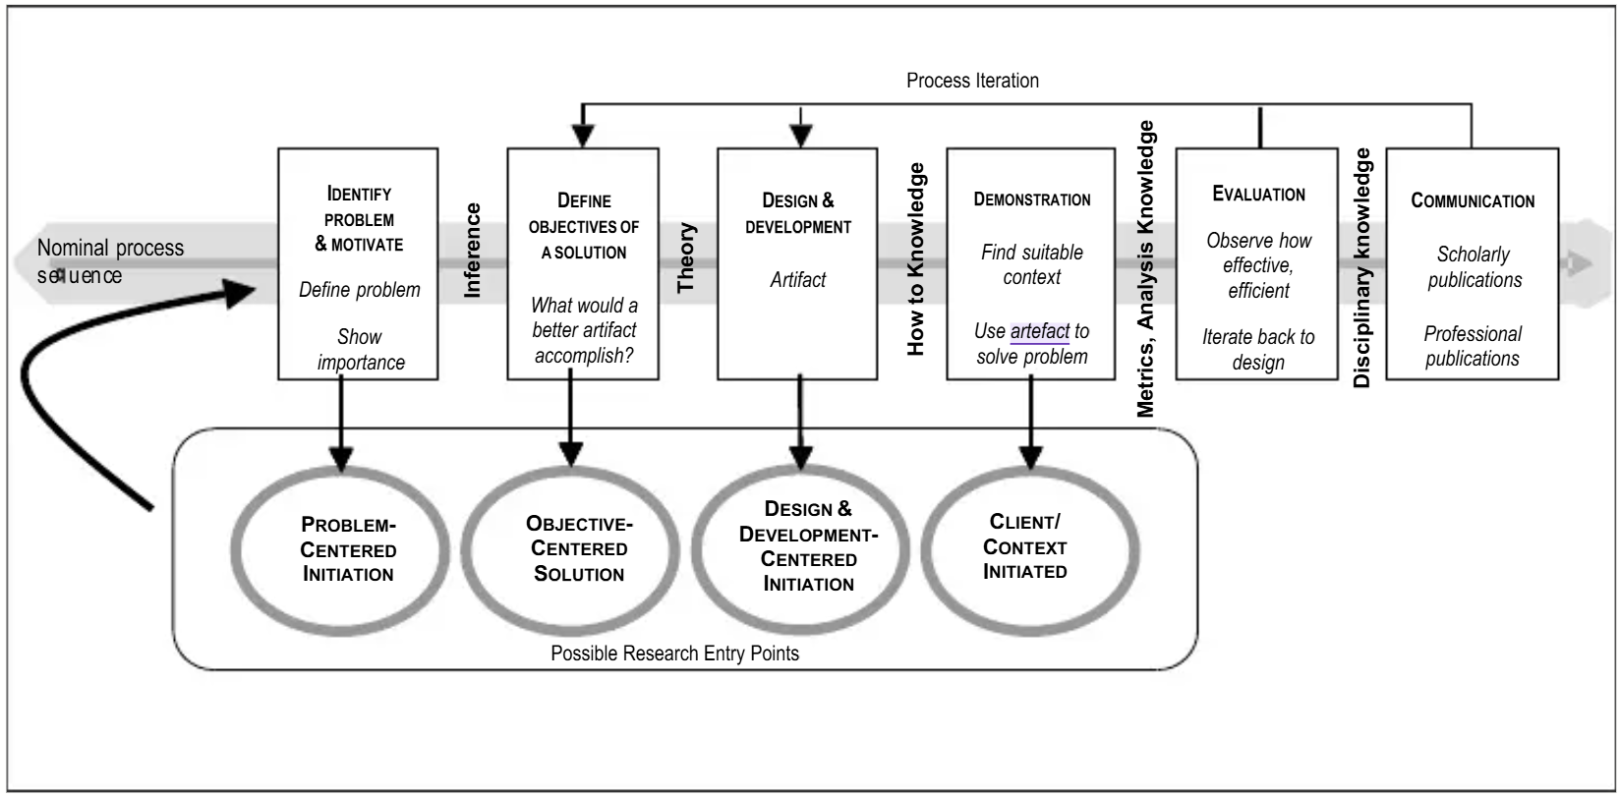
Methodology: Design Science Research
Problem identification
Objectives
Design & development
Demonstration
Evaluation
Communication
Peffers (2007)
Notes:
I used the Design Science Research Methodology (DSRM), which is ideal when the goal is to build and evaluate a technological artefact.
Six stages guided the project:
Problem identification
Define objectives
Design & development
Demonstration
Evaluation
Communication
This approach allowed me to build a real operational tool while generating academically transferable design principles.

Slide 7
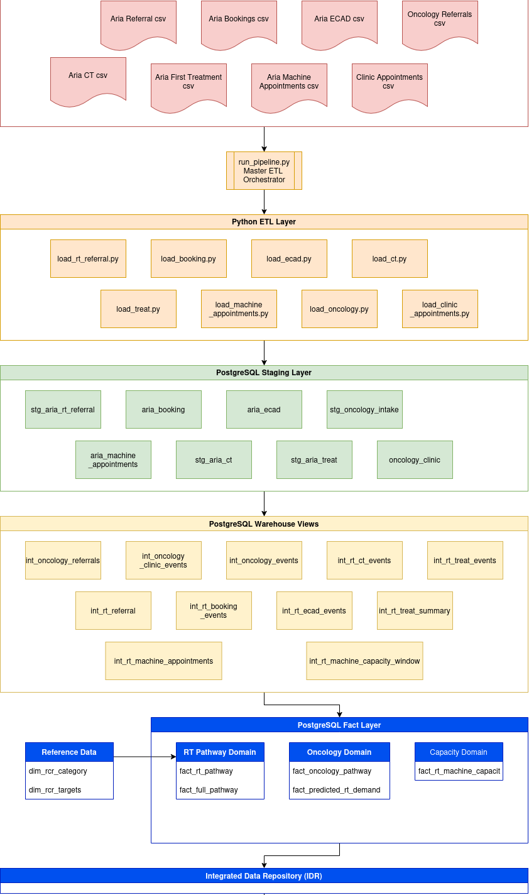
The Artefact: Integrated Data Repository
Python + PostgreSQL ETL
Staging → Integration → Fact layers
Harmonised pathway events
Automated refresh
Revealed data-quality issues
Duplicates
Missing outcomes
Manual update delays
Notes:
The IDR integrates three operational datasets:
Oncology referral register (SharePoint)
PAS clinic activity
Aria radiotherapy workflow data
A layered architecture was implemented:
Staging layer — raw extracts
Integration layer — harmonisation, business rules
Fact layer — analytics‑ready tables
Power BI dashboards
A key insight from development:
“Repository development identified previously unrecognised operational data‑quality issues including duplicate referral records and incomplete clinic outcome recording.”
This alone demonstrated the value of integrating siloed systems.

Slide 8
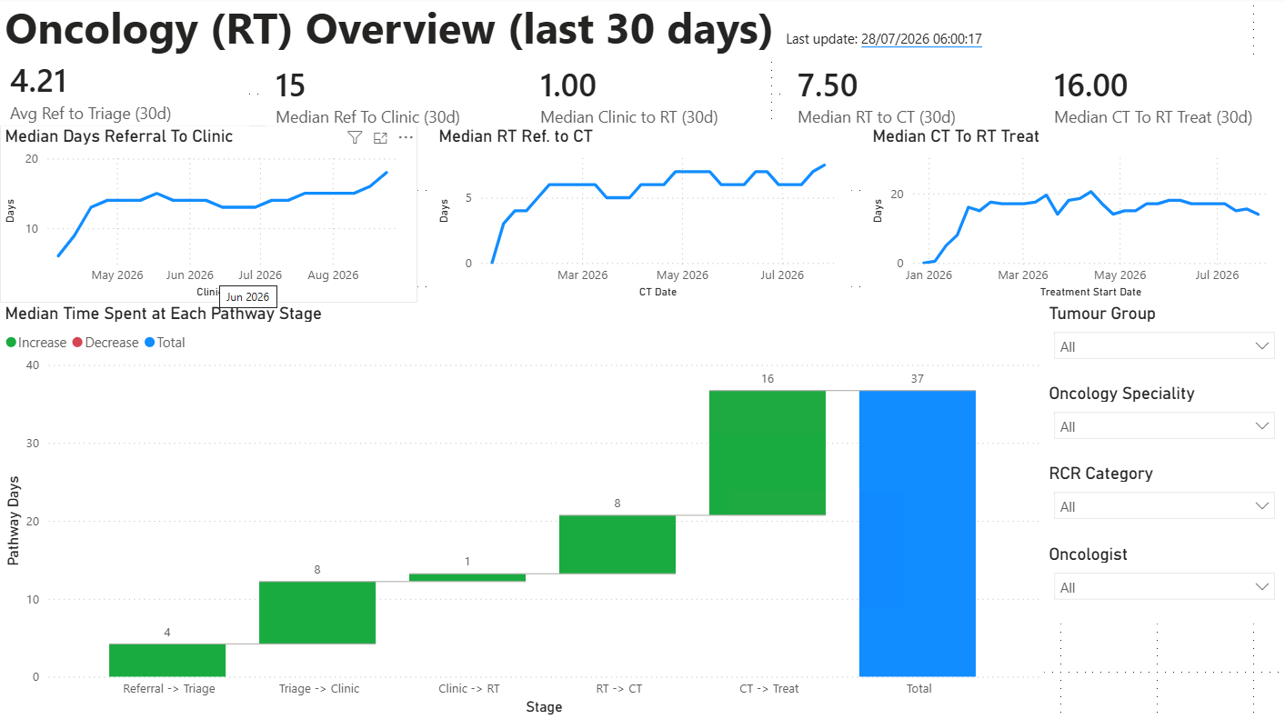
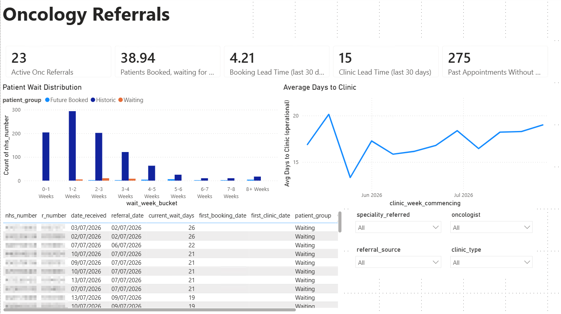
Dashboard Suite
Notes:
1. Oncology Referral Dashboard
Shows active referrals, waiting times, booking lead times, and missing clinic outcomes.
2. Integrated Post‑MDT Pathway Dashboard
Provides end‑to‑end visibility from referral → clinic → CT → treatment.
Each dashboard is task‑oriented, aligning with ISO 9241‑110 usability principles.

Slide 9
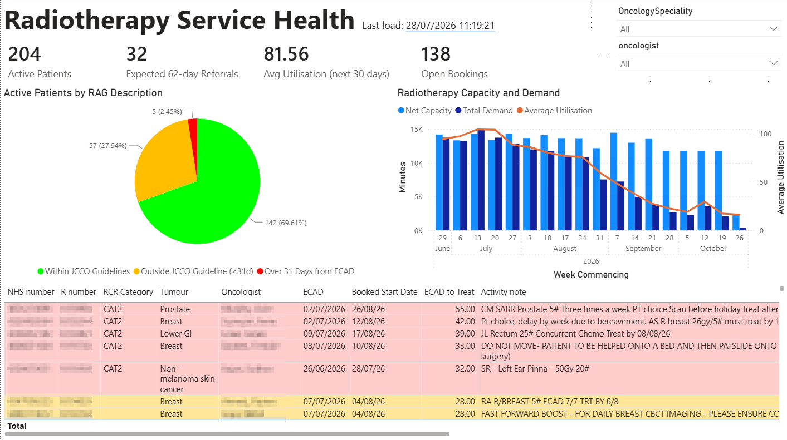
Dashboard Design
Three dashboards
Oncology Referrals
Overall Pathway
RT Operations
Designed using ISO 9241-110
Notes:
2. Radiotherapy Service Health Dashboard
Shows capacity utilisation, demand forecasting, and patient risk categories.

Slide 10
Pathway Delays
Stage | Days
Referral → Triage | 4
Triage → Clinic | 8
Clinic → RT Referral | 1
RT Referral → CT Sim | 8
CT Sim → Treatment | 16
Total | 37
Median post MDT pathway: 37 days
Longest delay:
CT Simulation → Treatment
Additional activities not captured
Planning, QC etc.
Triage → Clinic: 8 days
RT Referral → CT Simulation: 8 days
Admin delays
Notes:
Two bottlenecks dominate:
1. Triage → First Oncology Clinic (8 days)
This reflects clinic access, booking efficiency, and triage workflow.
2. CT Simulation → Treatment Start (16 days)
This includes contouring, planning, QA, and booking — none of which are visible in existing reporting systems.
As the dissertation notes:
“The largest delay occurred between CT simulation and treatment initiation (16 days).”

Slide 11
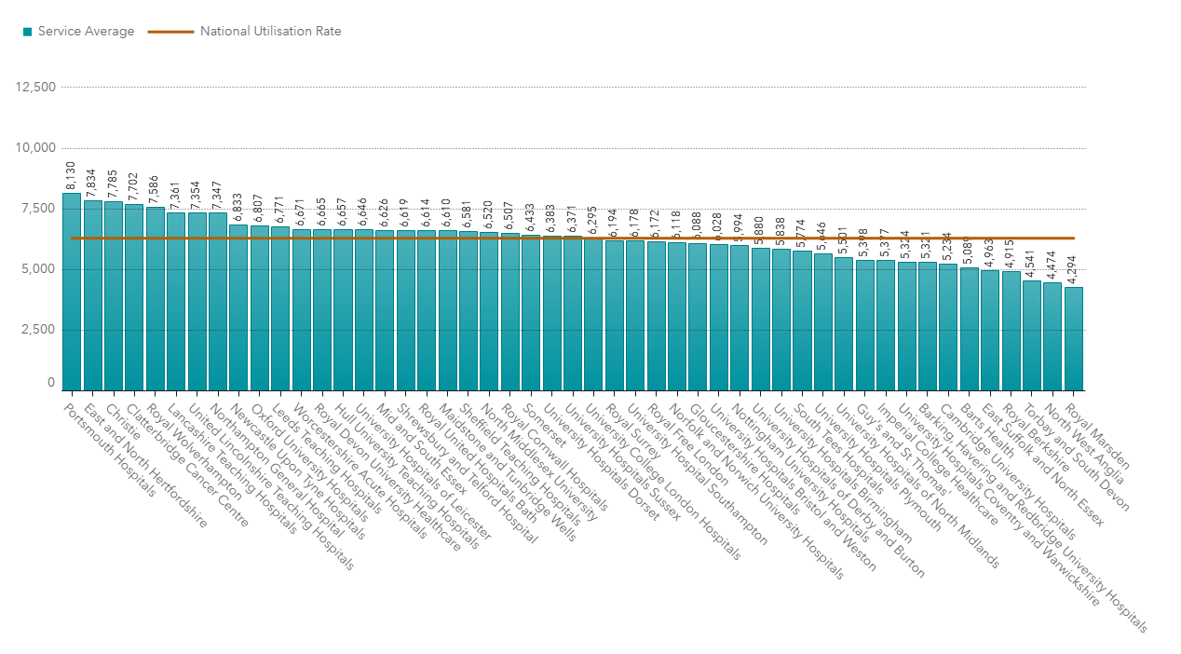
Radiotherapy Capacity Insights
81.56% utilisation
Portsmouth highest utilisation in the country
Risk stratification
69.6% within JCCO recommendations
27.9% outside JCCO, inside national targets
2.45% breaching 31-day standard
Ash (2004)
NHS Digital (2026)
Notes:
The radiotherapy dashboard showed:
204 active patients
32 predicted future referrals
81.56% utilisation, above the 80% planning threshold
Portsmouth had the highest linac utilisation in England (RAD20 dataset)
Risk stratification revealed:
69.6% within JCCO guidelines
27.9% outside JCCO but within national targets
2.45% breaching the 31‑day standard
This validated the need for proactive breach‑risk monitoring.

Slide 12
Evaluation Results
Participant | SUS Score
P1 | 95.0
P2 | 90.0
P3 | 95.0
Mean | 93.3
SUS Score: 93.3
Stakeholders
Clinical Director
RT Ops Manager
Lead Radiographer
Reported benefits:
Improved visibility
Earlier breach detection
Reduced manual reporting
Operational adoption likely
Notes:
Three senior stakeholders evaluated the dashboards:
Clinical Oncology Director
Radiotherapy Operations Manager
Lead Treatment Radiographer
System Usability Scale (SUS): 93.3
A score above 90 is considered “excellent” usability.
Participants strongly agreed that the dashboards:
Improved visibility
Supported proactive breach prevention
Reduced manual reporting
Would be used in routine operations

Slide 13
Design Principles
Surface breach risks early
01
Pair risks with capacity
02
Use canonical pathway events
03
Refresh at operational cadence
04
Preserve provenance
05
Align dashboards with real tasks
06
Notes:
Six evaluated design principles emerged:
Surface breach risks early
Pair risks with capacity data
Use canonical pathway events
Refresh data at the operational cadence
Preserve provenance and auditability
Align dashboards with real operational tasks
These principles form the transferable academic contribution of the study.

Slide 14
Limitations
Single-site study
Small user sample group
Dependant on source-system data quality
CT → Treatment interval aggregates hidden processes
Evaluation focused on usability, not outcomes
Notes:
Single‑site study
Dependent on source‑system data quality
CT→Treatment interval aggregates multiple hidden processes
Evaluation focused on usability, not patient outcomes

Slide 15
Future Work
Digital referral integration
SACT dataset integration
Decomposition of CT → Treatment workflow
Clinic-capacity modelling
Notes:
Four major enhancements:
Integration of digital referral pathways Already underway with Urology → Oncology e‑referrals.
SACT dataset integration Planned after regional system upgrade.
Decomposition of CT→Treatment interval Adding contouring, planning, QA, booking events.
Clinic‑capacity modelling Distinguishing new‑patient vs follow‑up demand.

Slide 16
Conclusion
Lightweight IDR improves visibility
Dashboards reveal hidden bottlenecks
Supports proactive operational management
Provides transferable design principles
Enables faster, more reliable progression to treatment
Notes:
This study demonstrates that:
Significant operational insight can be achieved without replacing existing clinical systems.
A lightweight IDR can unify fragmented data and expose bottlenecks previously invisible.
The dashboards materially improve operational visibility, decision‑making, and breach‑risk management.
The evaluated design principles provide transferable knowledge for NHS oncology analytics.
As the dissertation concludes:
“Meaningful improvements in operational visibility can be achieved through lightweight data integration approaches.”
Thank you.

Slide 17
References
Ash, D., Barrett, A., Hinks, A. and Squire, C. (2004) ‘Re-audit of radiotherapy waiting times 2003,’ Clinical Oncology, 16(6), pp. 387–394
Johnson, Peter (2024) ‘Updating the NHS cancer waiting time standards,’ BMJ Oncology, 3(1)
NHS Digital (2026b) ‘RTDS quality dashboard,’ Available at: https://digital.nhs.uk/ndrs/data/data-outputs/data-quality-and-insights-hub/rtds-hscn-quality-dashboard (Accessed: 2026-03-01)
Peffers, Ken, Tuunanen, Tuure, Rothenberger, Marcus A. and Chatterjee, Samir (2007) ‘A design science research methodology for information systems research,’ Journal of Management Information Systems, 24(3), pp. 45–77

